Slide 1
The re – evolution of the Mexico´s city Metro
PrÓXIMA ESTACIÓN…ESPERANZA

Slide 2

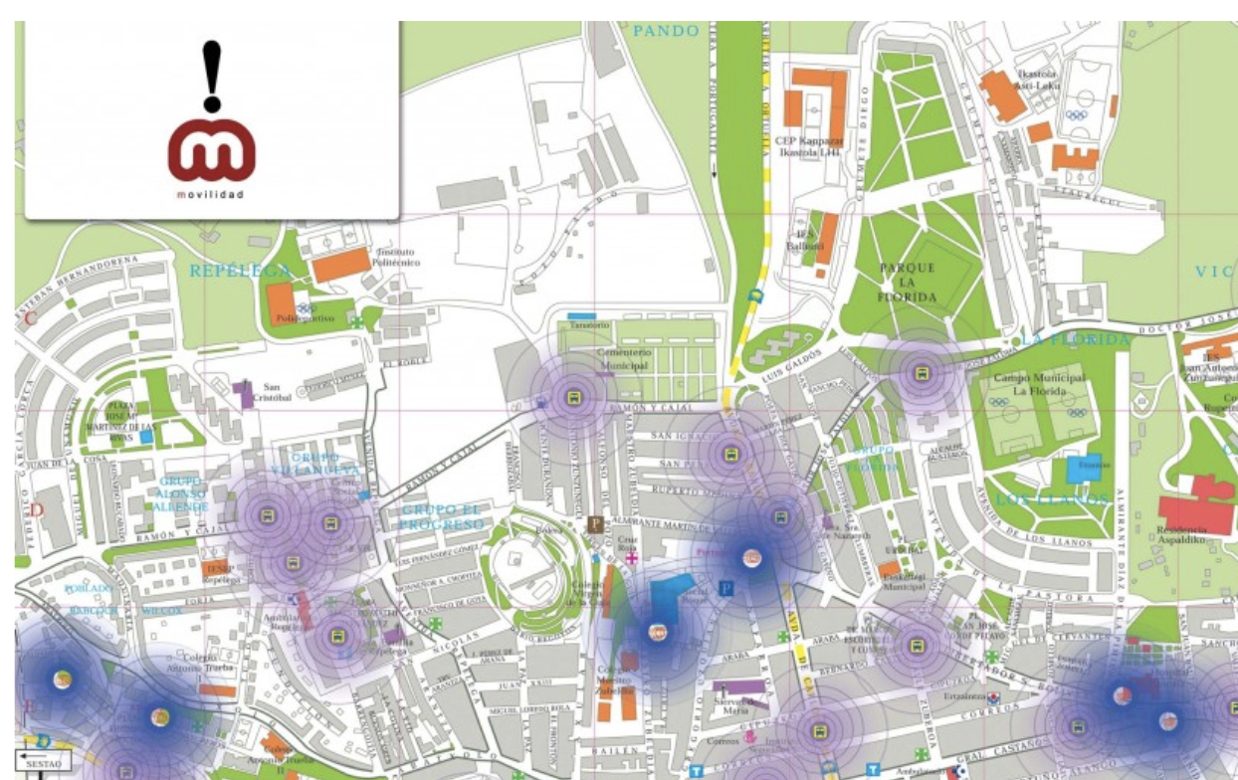
Here we are going to tell the story related with the mobility in MX city metro through recent years with a historical inflow graph
Here, the user can select the metro line, or station, to review which is the best option
We will be able to show a historical inflow graph right here

